Slide 1
Chapter 5: Structural Modeling

Slide 2
Objectives
Understand the rules and style guidelines for creating CRC cards, class diagrams, and object diagrams.
Understand the processes used to create CRC cards, class diagrams, and object diagrams.
Be able to create CRC cards, class diagrams, and object diagrams.
Understand the relationship among structural models.
Understand the relationship between structural and functional models.

Slide 3

Introduction
Functional models represent system behavior
Structural models represent system objects and their relationships:
People
Places
Things

Slide 4
Structural Models
Drawn using an iterative process
First drawn in a conceptual, business-centric way
Then refined in a technology-centric way describing the actual databases and files
More and more detail is added in each iteration
Create a vocabulary for analysts & users
Allows effective communication between analysts & users

Slide 5

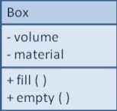
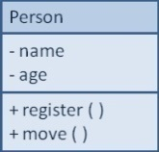
Structural Models
Main goal: to discover the key data contained in the problem domain and to build a structural model of the objects
Structural
Modeling
Solution Domain
Problem Domain
Notes:
대상 분야 문제에 포함된 주요 자료를 찾아내고ㅗ 객체들의 structural 모델을 만든다.

Slide 6
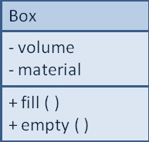
Classes, Attributes, & Operations
Classes
Templates for instances of people, places, or things
Attributes
Properties that describe the state of an instance of a class (an object)
Operations
Actions or functions that a class can perform

Slide 7
Relationships
Describe how classes relate to one another
Three basic types in UML
Generalization
Enables inheritance of attributes and operations
Represents relationships that are “a-kind-of”
Aggregation
Relates parts to wholes or assemblies
Represents relationships that are “a-part-of” or “has-parts”
Association
Miscellaneous relationships between classes
Usually a weaker form of aggregation

Slide 8
Object Identification
Textual analysis of use-case information
Nouns suggest classes
Verbs suggest operations
Creates a rough first cut to provide an object list
Use-case description
Textual Analysis
Potential object Potential operation

Slide 9
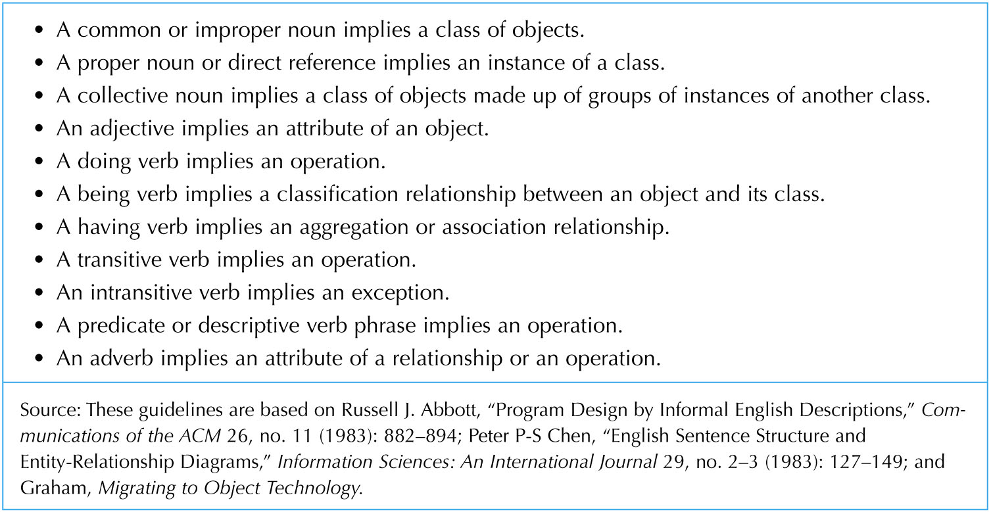
Object Identification

Slide 10
Object Identification
Brainstorming—people offering ideas – use-case 사용 않함.
Initial list of classes (objects) is developed
Attributes, operations and relationships to other classes can be assigned in a second round
Question or statement
(개인의)Past experience
Candidate class
Discuss & select
Classes
Identify att, op, rel
Class, op, att, rel

Slide 11
Object Identification (cont.)
Common Object Lists
Physical things – 문제영역 사물들 찾기 쉽다-의자, 책상…
Incidents – 문제영역 이벤트 : 미팅, 비행, 사건, performance
Roles – use case에 나타난 사람의 역할 – 의사, 간호사, 환자
Interactions – 문제의 영역에서 트랜잭션 형태로 나타남 – 판매,
문제 분야에서 공통으로 나타나는 “common object list”
Problem domain
Find Common object list
Common object list

Slide 12
Object Identification (cont.)
Patterns
Useful groupings of collaborating classes that provide solutions to common problems (are reusable)
Developed patterns provide a starting point for work in similar domains
비교적 최근에 나타난 영역
이 관점에서는 공통으로 나타나는 분야에 대하여 협력하는 클래스들의 useful 그룹을 패턴이라 정리
Potential object Potential operation
Object pattern
패턴을 적용한
Class, op, att, rel
Class, op, att, rel
Common obj. list
Predefined reusable patterns (fig 5.5)

Slide 13
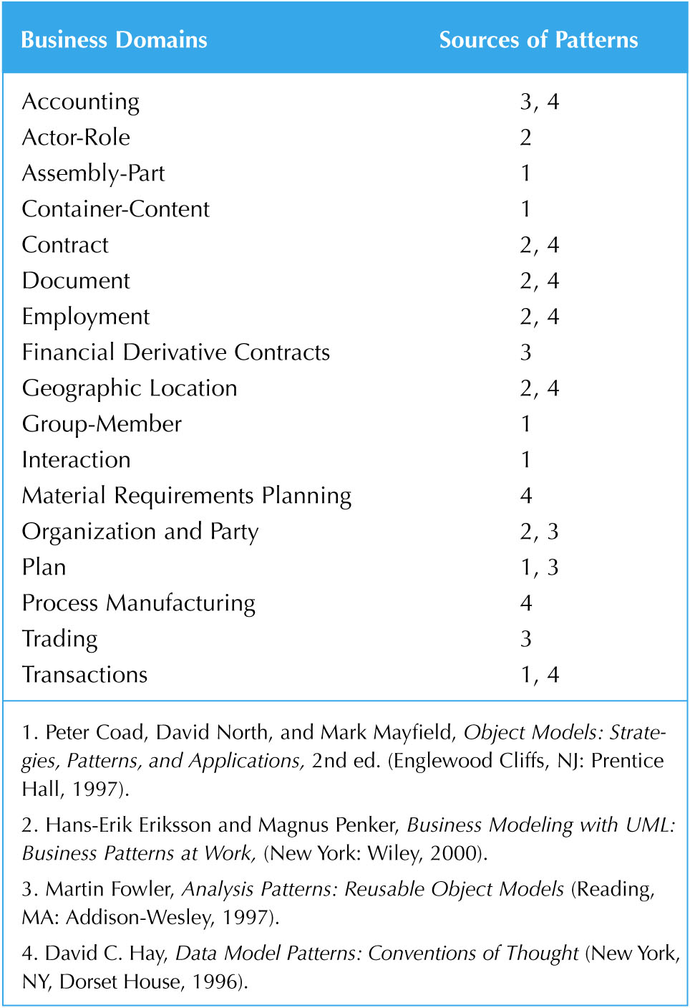
Object Identification (cont.)

Slide 14
CRC(class responsibility collaborations) Cards
Index cards used to document the responsibilities and collaborations of a class
Responsibilities(클래스의 의무)
Knowing—what a class must know manifested as attributes
Doing—what a class must do manifested later as operations
Collaboration
Objects working together to service a request:
Requestor (client)
Responder (server)
Bound by a contract
객체들 사이의 계약 관계를 이용하여 class를 id.한다.
Notes:
Unified process development high tech
CRC based low tech based – unified process와 경쟁관계로 보는 문헌도 있다.
이 책에서는 보완하는 쪽을 활용한다.

Slide 15
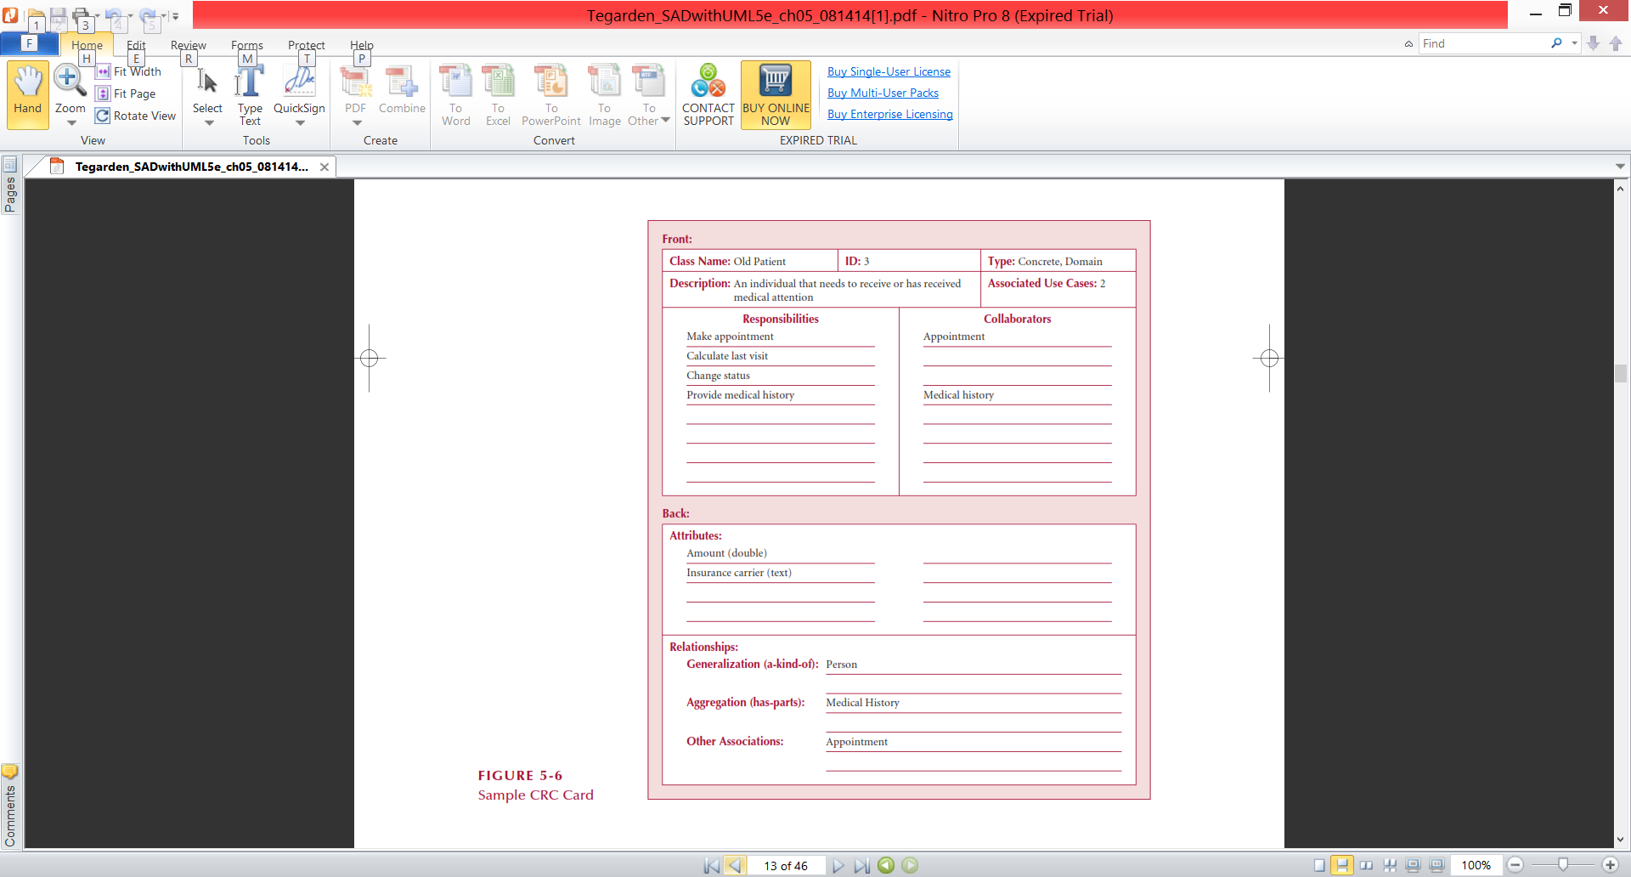
Front-Side of a CRC Card

Slide 16
Back-Side of a CRC Card

Slide 17
CRC Cards & Role-Playing
An exercise to help discover additional objects, attributes, relationships & operations
Team members perform roles associated with the actors and objects previously identified
Utilize activity diagrams to run through the steps in a scenario
Identify an important use-case
Assign roles based on actors and objects
Team members perform each step in the scenario
Discover and fix problems until a successful conclusion is reached
Repeat for remaining use-cases

Slide 18
CRC Cards & Role-Playing
앞절에서 찾은 class들
초기 crc 카드 작성
Missing properties
Use-case
Anthoropomorphism & role play
CRC cards

Slide 19
Role-Playing
방법
1. review use cases
가장 중요하고 복잡하고 이해도가 적은 use-case를 고른다
2. identify relevant actors & objects
선택한 use-case에 관련된 객체 액터를 찾는다.
객체나 액터의 역할을 찾는다.
각 역할을 팀원에게 부여한다.
3. Role-play scenarios
팀원이 역할을 수행
Scenario를 따라가며 explicit 정보를 찾는다. 성공하면
다음 시나리오를 고른다.

Slide 20
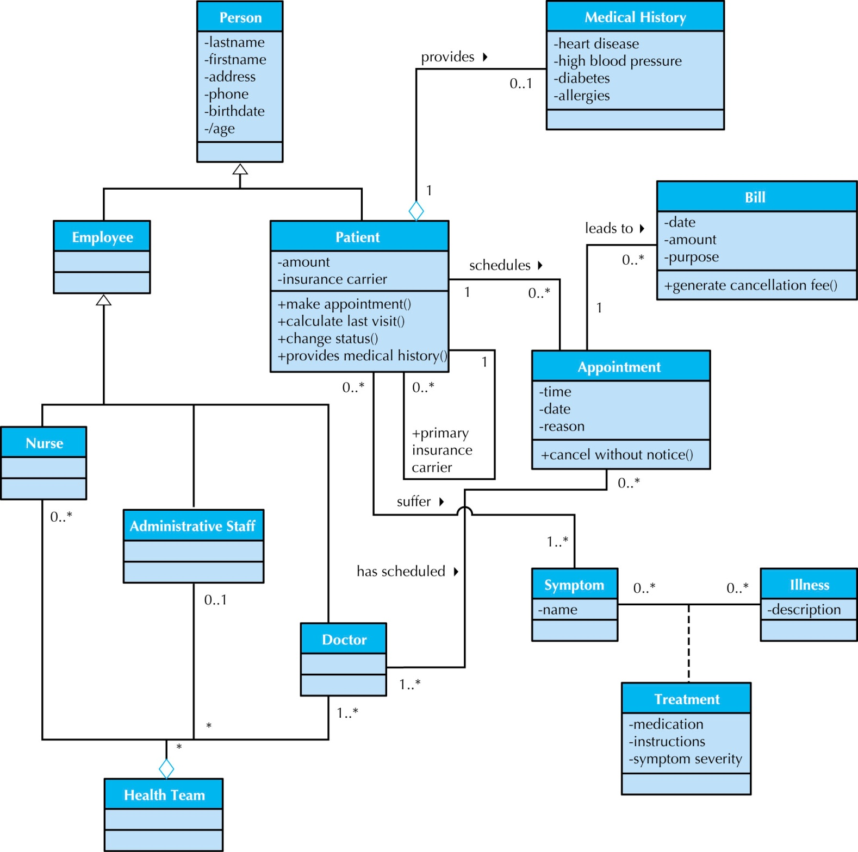
Class Diagrams

Slide 21
Class Diagrams
A static model that shows classes and their relationships to one another
Elements
Classes
Objects within the system (a person, place or thing)
Stores and manages information in the system and contains:
Attributes—characteristics of the class
Operations—activities the class can perform
Relationships—the associations between classes
Depicted as lines between classes
Multiplicity indicates how many of one object is/are associated with other objects

Slide 22
Attributes
Properties of a class
Person: last name, first name, address, etc.
Attributes can be derived
Preceded with a slash (/)
e.g., age is derived from date of birth
Visibility of an attribute:
Restricts access to attributes to ensure consistency
Public attributes (+): visible to all classes
Private attributes (-): visible only to an instance of the class in which they are defined
Protected attributes (#): visible only to an instance of the class in which they are defined and its descendants

Slide 23
Operations
Common operations are not shown
Create or delete an instance
Return or set a value
Types of operations:
Constructor—creates an object
Query—makes information about the state of an object available
Update—changes values of some or all of an object’s attributes
Destructor—deletes or removes an object

Slide 24
Relationships
Denotes associations between classes
Depicted with a line labeled with the name of the relationship
May be directional (depicted with a triangle; e.g., a patient schedules an appointment)
Classes may be related to themselves (e.g., employees and managers who may be members of the same class)
Multiplicity indicates how many of one class are related to another class

Slide 25
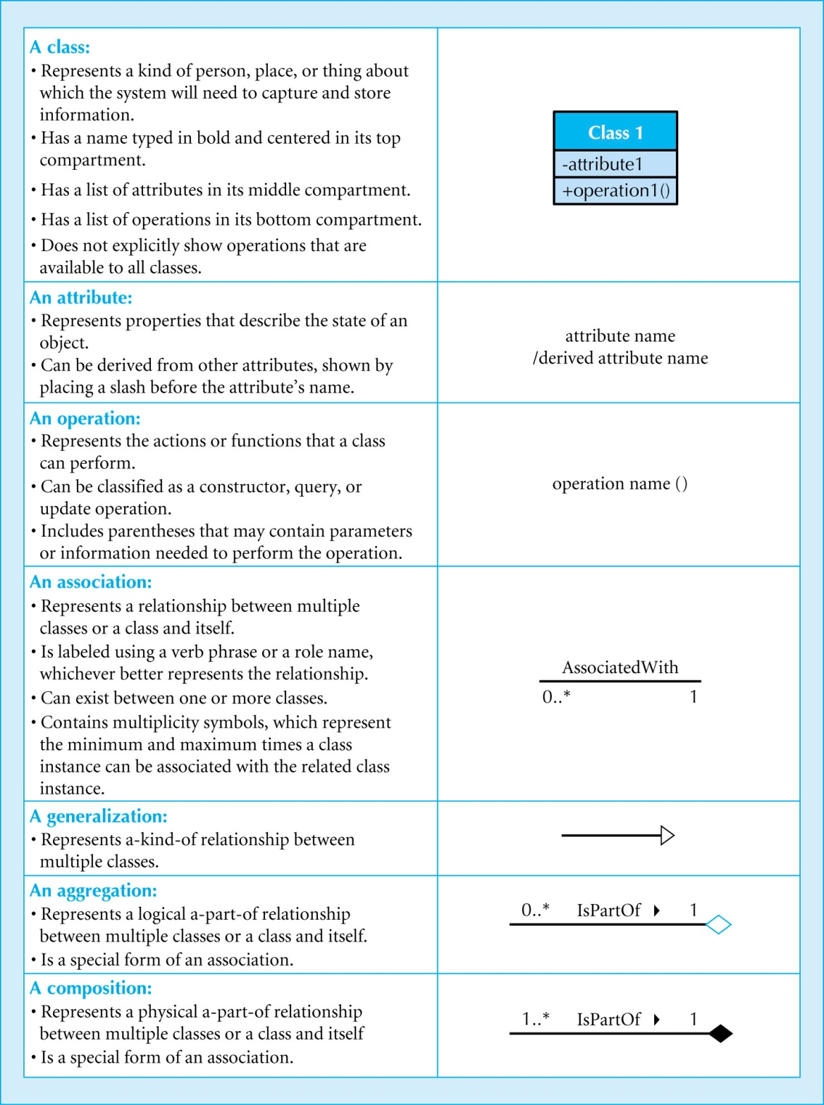

Slide 26
Multiplicities
Department
Boss
Exactly one:
A department has one and only one boss
1
1
Employee
Child
Zero or more:
An employee has zero to many children
1
0..*
Boss
Employee
One or more:
A boss is responsible for one or more employees
1
1..*

Slide 27
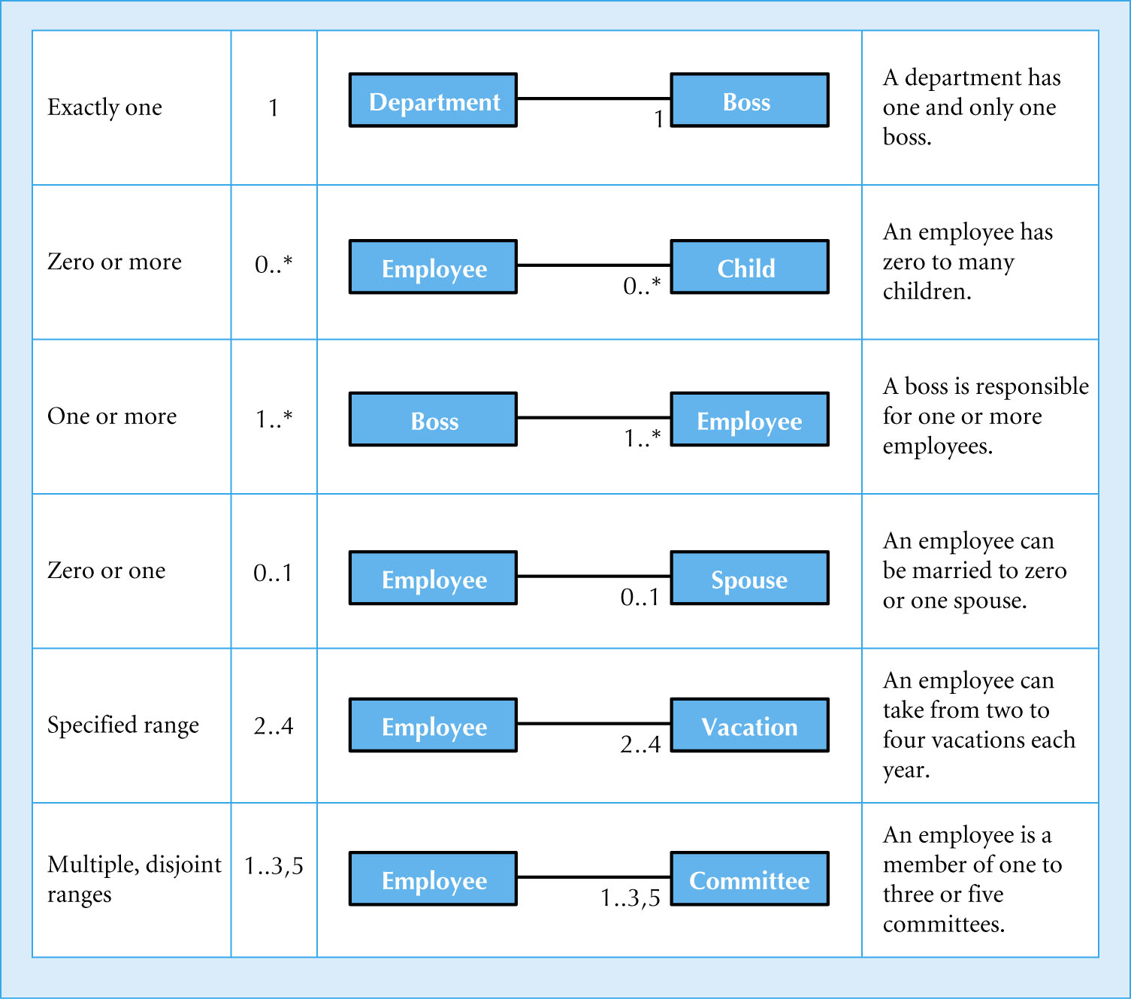

Slide 28
Association Classes
Common in many-to-many relationships
Used when attributes about the relationship between two classes needs to be recorded
Students are related to courses; a Grade class provides an attribute to describe this relationship
Illnesses are related to symptoms; a Treatment class provides an attribute to describe this relationship
Notes:
관계가 attribut를 가질 때 association class

Slide 29
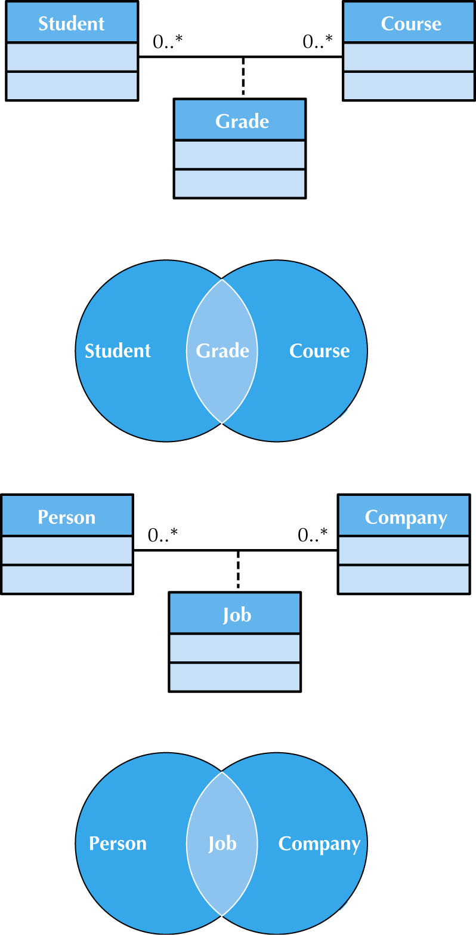

Slide 30
Generalization & Aggregation Associations
Generalization denotes inheritance
Properties and operations of the superclass are valid for the sub-class
Depicted as a solid line with a hollow arrow pointing at the superclass
Aggregation denotes a logical “a-part-of” relationship
Composition denotes a physical “a-part-of” relationship

Slide 31
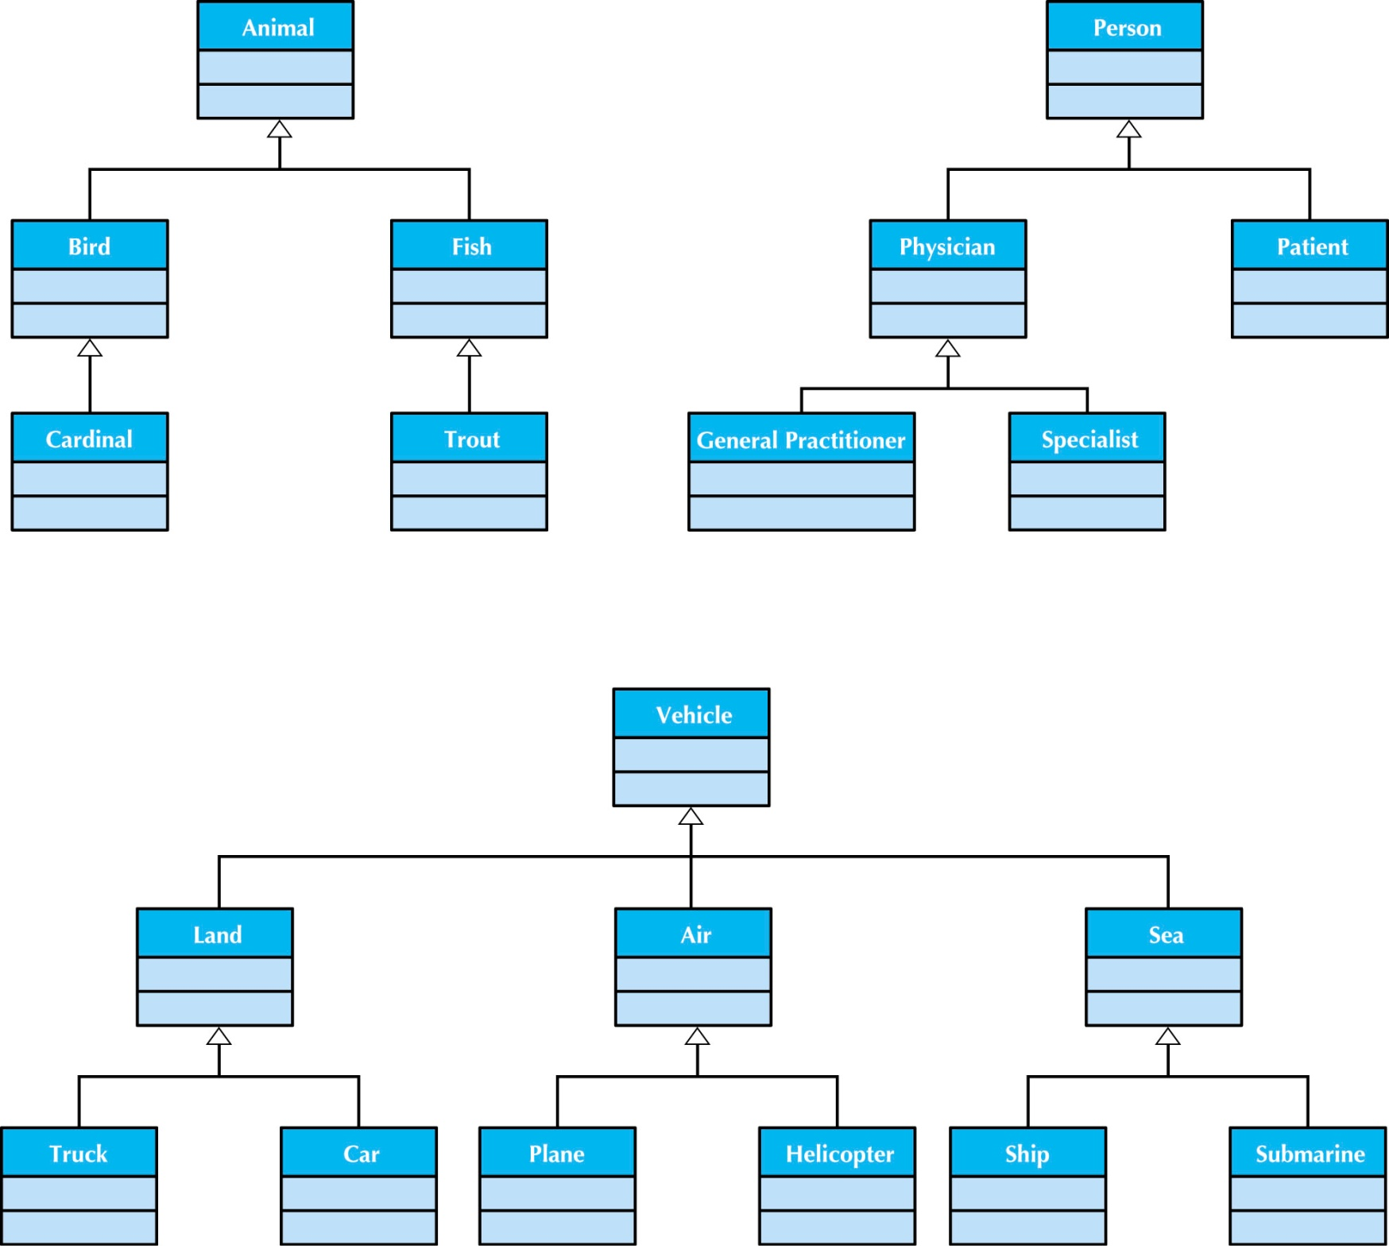

Slide 32
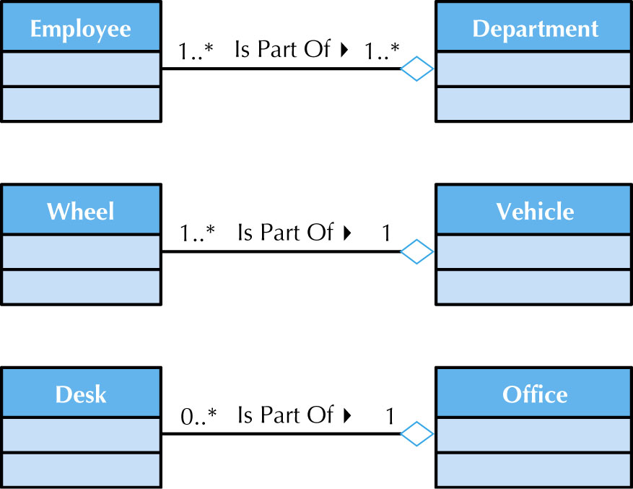

Slide 33
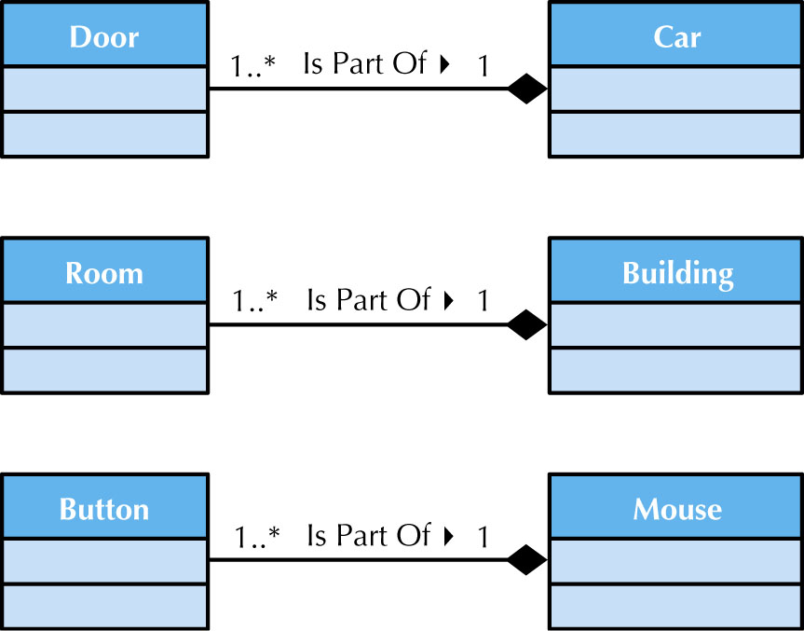

Slide 34
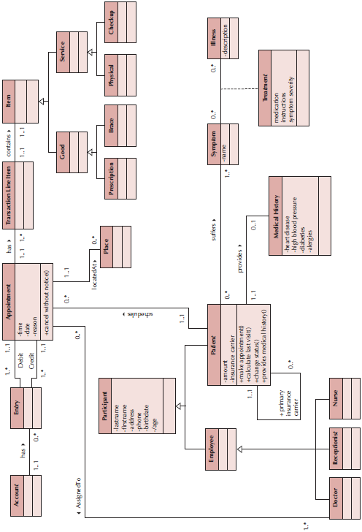
Sample Class Diagram

Slide 35
Simplifying Class Diagrams
Fully populated class diagrams of real-world system can be difficult to understand
너무 많아서 복잡해지면 간단하게 표현하여 이해한다.
Common ways of simplifying class diagrams:
Show only concrete classes – 더 어려워 질 수 있다.
The view mechanism shows a subset of classes
특정 use-case에 해당하는 클래스만 그린다.
클래스의 관계 중에서 관심있는 관계만(generalization, aggregation, association)
클래스의 일부만(이름과 관계, 이름과 op만)
Packages show aggregations of classes (or any elements in UML)

Slide 36
Simplifying Class Diagrams
Packages show aggregations of classes (or any elements in UML)
Package : logical groups of classes

Slide 37
Object Diagrams
Class diagrams with instantiated classes
Example: instead of a Doctor class, create an actual doctor, say Dr. Smith
Place values into each attribute
Used to discover additional attributes, relationships and/or operations or those that are misplaced

Slide 38
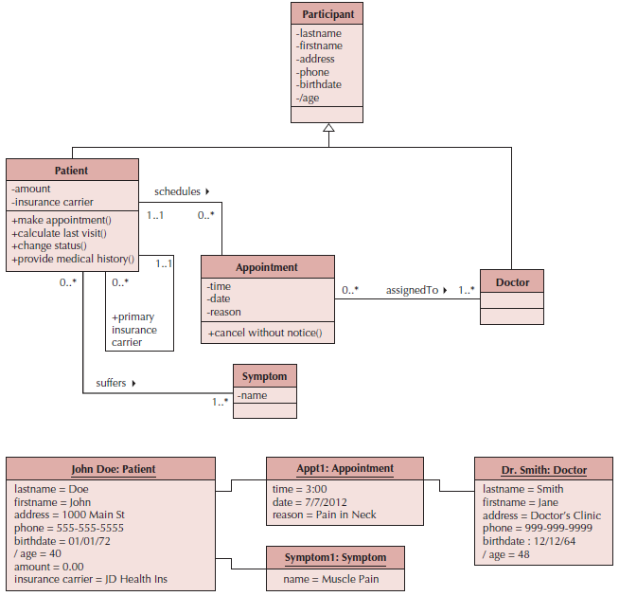
Example Object Diagram

Slide 39
7 Steps to Structural Models
Create CRC Cards
Review CRC Cards & identify missing objects, attributes, operations and/or relationships
Role-play the CRC cards—look for breakdowns & correct; create new cards as necessary – 개인이 crc 카드의 객체 역할 수행
Create the class diagram crc 카드를 이용하여 객체 작성\
Responsibility → operation, attribute, relationship
Attribute private, operation public : default 값
관계 정리(aggregation, generalization)

Slide 40
7 Steps to Structural Models
Review the class diagram—remove unnecessary classes, attributes, operations and/or relationships
지금까지는 더해 왔고 지금 부터는 제거한다.
Incorporate patterns
유사 패턴을 찾아서 적용 후 crc 카드 갱신
Review and validate the model

Slide 41
CRC Cards & Role-Playing
Use-case
2.Review crc cards
1.Create crc cards (textual analys)
CRC cards
Missing obj, att,op,rels.
3.Role play
additional obj, att,op,rels.
4.Create class diagram
Class Dia.
5.Review class diagram
존재이유
7.Review the model
6.Incorporatepatterns
Predefined reusable patterns (fig 5.5)

Slide 42
Verifying & Validating the Model
Analyst presents to developers & users
Walks through the model
Provides explanations & reasoning behind each class
Rules
Each CRC card is associated with a class
Responsibilities on the front of the card are included as operations on the class diagram
Collaborators on the front of the card imply a relationship on the back of the card
Attributes on the back of the card are listed as attributes on the class diagram

Slide 43
Rules for Validating & Verifying the Model (cont.)
Attributes on the back of the CRC card each have a data type (e.g., salary implies a number format)
Relationships on the back of the card must be properly depicted on the class diagram
Aggregation/Association
Multiplicity
Association classes are used only to include attributes that describe a relationship

Slide 44
EXAMPLE

Slide 50
Fig 5-20

Slide 56
Summary
Structural Models
CRC Cards
Class Diagrams
Creating CRC Cards and Class Diagrams

